Slide 1
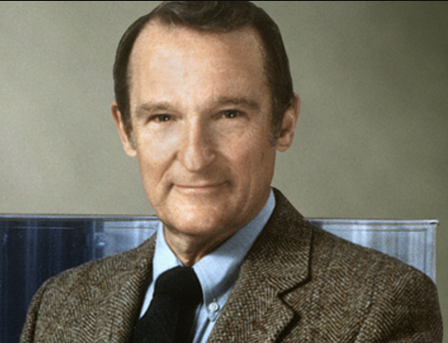
Seymour Cray
American electrical engineer and supercomputer architect

Slide 2
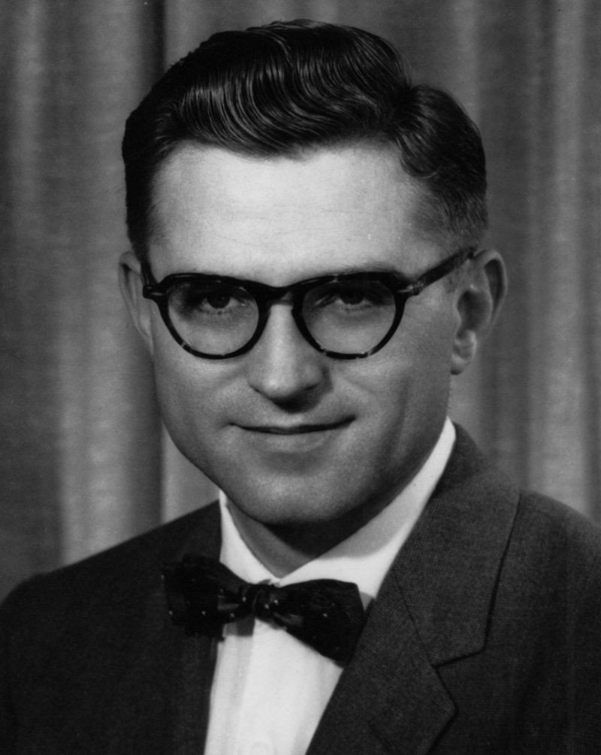
Early Life
Seymour Roger Cray was born on September 28, 1925 in Chippewa Falls, Wisconsin.
He built a device out of Erector Set components that converted punched paper tape into Morse code signals when he was ten years old.
He was drafted, at the age of 18, for World War II as a radio operator, where he worked on breaking Japanese naval codes.

Slide 3

Schooling
He graduated from Chippewa Falls High School in 1943.
Went to the University of Minnesota, to earn his Bachelor of Science in Electrical Engineering, and graduated in 1949.
Received Master of Science in applied mathematics in 1951.

Slide 4
Engineering research associates (ERA)
In 1951, Cray joined Engineering Research Associates (ERA), which was formed out of a United States Navy laboratory that built codebreaking machines.
Cray quickly climbed the ranks, becoming known as an expert on digital computer technology. Also receiving the nickname “The Wizard of Chippewa Falls”.
He earned this title from his design work on the ERA 1103, the first commercially successful scientific computer.

Slide 5
Control Data Corporation (CDC)
The scientific computing division was beginning to shut down in 1957, numerous employees formed Control Data Corporation (CDC).
Cray wanted to join as well, but the CEO William Norris, initially refused because Cray was right in the middle of a project for the Navy, Norris did not want the Navy to harbor any ill-will.
He improved on the ERA 1103, with the low-cost CDC 1604, in 1960.

Slide 6
CDC (Continued)
He worked on the CDC 3000 series, which were for ‘business and commercial’ data processing, which disinterested Cray.
In terms of hardware the CDC 6600 was not the leading edge, but Cray realized that Input/output (I/O) bandwidth had to be maximized to avoid "starving" the processor of data to crunch.
The 6600 was the first commercial supercomputer, outperforming everything, the 6600 solved a critical design problem — "imprecise interrupts" —He did this by replacing I/O interrupts with a polled request issued by one of 10 built-in mini-computers that did all transfers in and out of the 6600's central memory.

Slide 7
Cray Research
Cray left the CDC after his project the CDC 8600, caused his budget to be cut.
He formed his own company Cray Research (Cray R&D), their first product was released in 1976 as the Cray-1.
The ILLIAC IV, a competitor companies computer, was able to perform on the same sort of level, but rarely operated near its maximum performance.

Slide 8
Cray Research (Continued)
Over 80 Cray-1s were sold, at approximately $8.8 million each, making the company a huge success financially.
The Cray-2 was hard to code for, and it only ran slightly faster than its competitors, resulting in much smaller sales.
The Cray-3 started to run into difficulties, resulting in the company funding another project.

Slide 9
Cray Computer Corporation
Causing Cray to form a spin off company, from his Colorado Springs laboratory, Cray Computer Corporation.
He took the Cray-3 project with him, but switched gears to the Cray-4, showcasing a prototype at NCAR on May 24, 1993.
The Cold War ending made future sales of the Cray-4 unlikely, the company filed for Chapter 11 bankruptcy March 24, 1995.

Slide 10
Personal life
Cray was divorced from his first wife, Verene, in 1975, and in 1980 married Geri M. Harrand.
Cray had three children: Susan, Carolyn, and Steven.
Cray claimed the secret of his success was accredited to "visits by elves" while he worked on a tunnel he built under his house: “While I'm digging in the tunnel, the elves will often come to me with solutions to my problem.”

Slide 11
Death/Legacy
Two weeks before October 5, 1996, Cray was involved in a serious car accident, which caused complications resulting in his death, at the age of 71.
The IEEE Computer Society's Seymour Cray Computer Engineering Award (1997), recognizes innovative contributions to high performance computing systems in memory of Cray's creative spirit.
Steve Jobs used a Cray X-MP for design work while planning the next-generation Apple Macintosh in the mid ‘80s.

Slide 12

What where the names of cray’s companies?

Slide 13

Cray Research & Cray Computer Corporation.

Slide 14
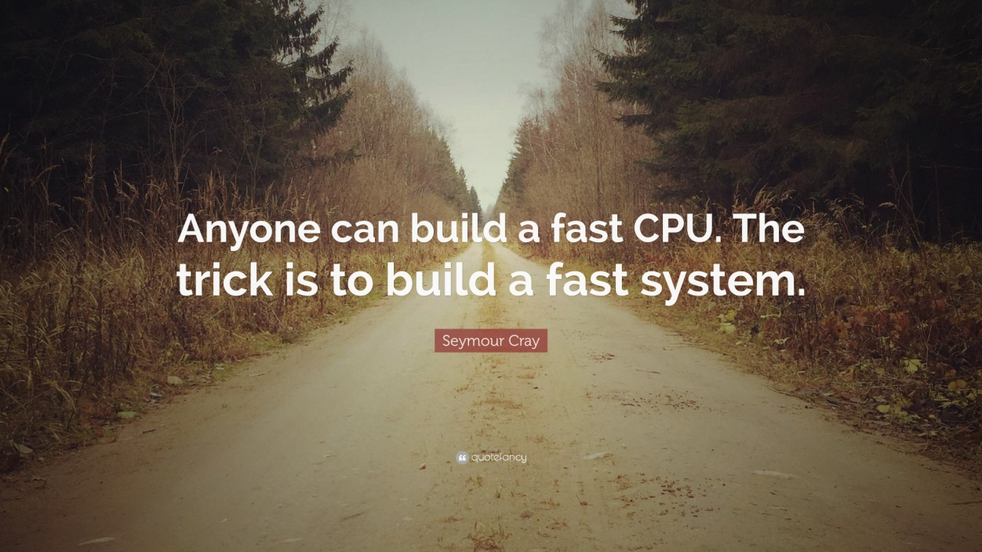
Works Cited
“Seymour Cray.” NNDB, Soylent Communications, www.nndb.com/people/936/000023867/.
“Seymour Cray.” Wikipedia, Wikimedia Foundation, 29 July 2017, en.wikipedia.org/wiki/Seymour_Cray.

